Slide 1


French PowerShell Saturday
PowerShell Classes Part2: Advanced Concepts and feedback from the field
Stéphane van Gulick
15 Septembre 2018 - #FrPwshSat2018

Slide 2

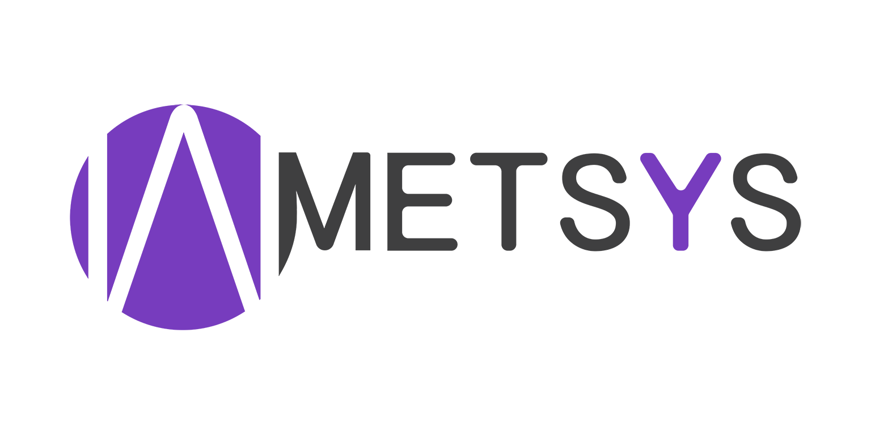

French PowerShell Saturday
Merci à nos sponsors !!
15 Septembre 2018 - #FrPwshSat2018

Slide 3

Introduction
15 Septembre 2018 - #FrPwshSat2018

Slide 4

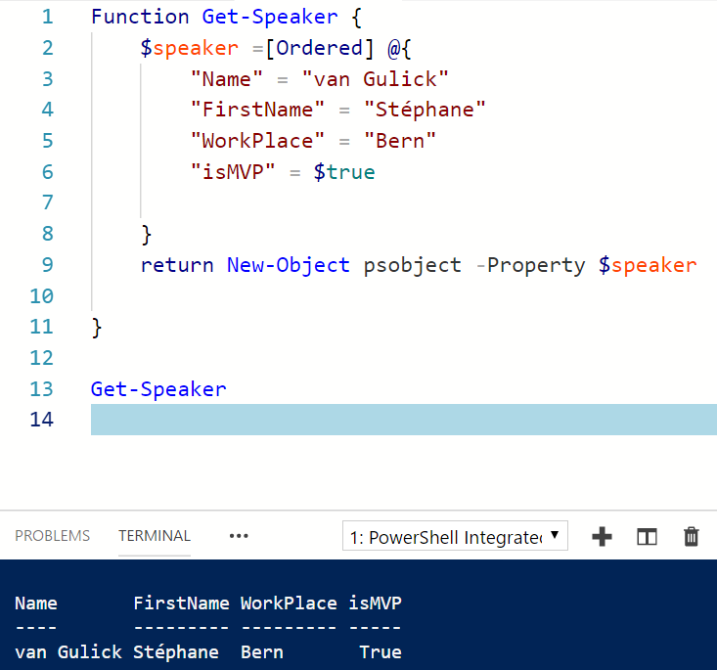
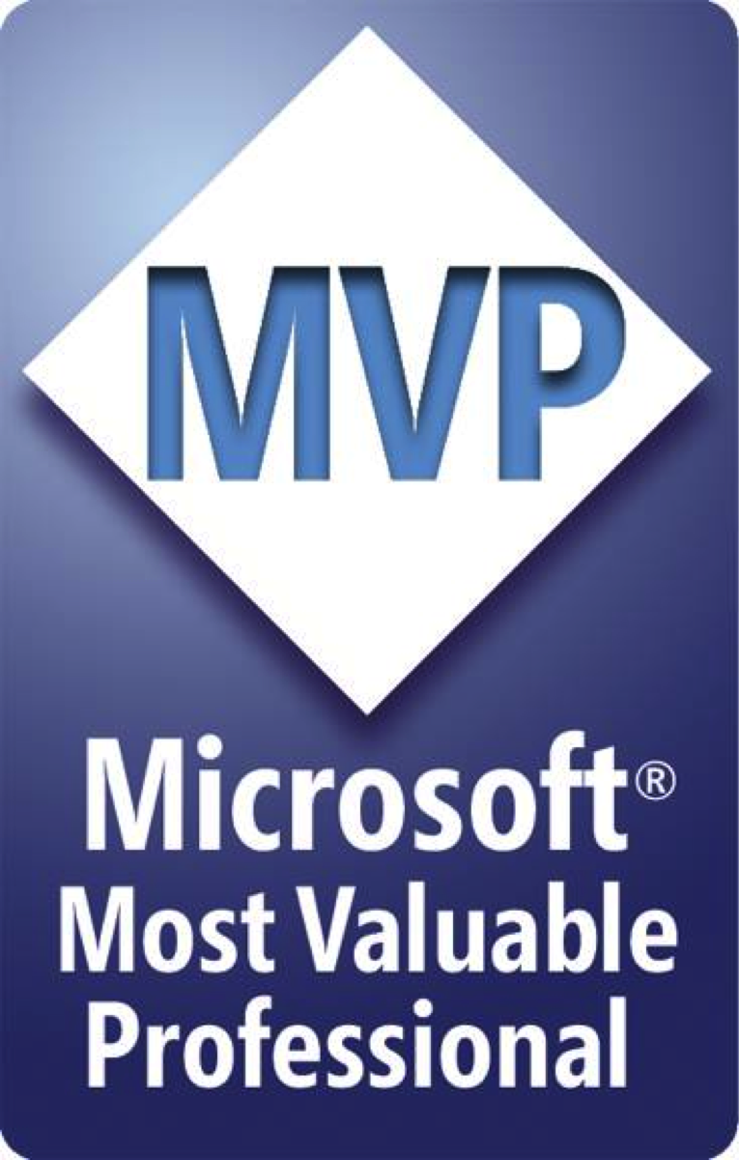

Introduction
15 Septembre 2018 - #FrPwshSat2018

Slide 5

Plan:
Learning what an object was
Learning class basics
Reusing knowledge
Looking forward
Making mistakes
15 Septembre 2018 - #FrPwshSat2018

Slide 6

Learning from the begining
The struggle
15 Septembre 2018 - #FrPwshSat2018

Slide 7
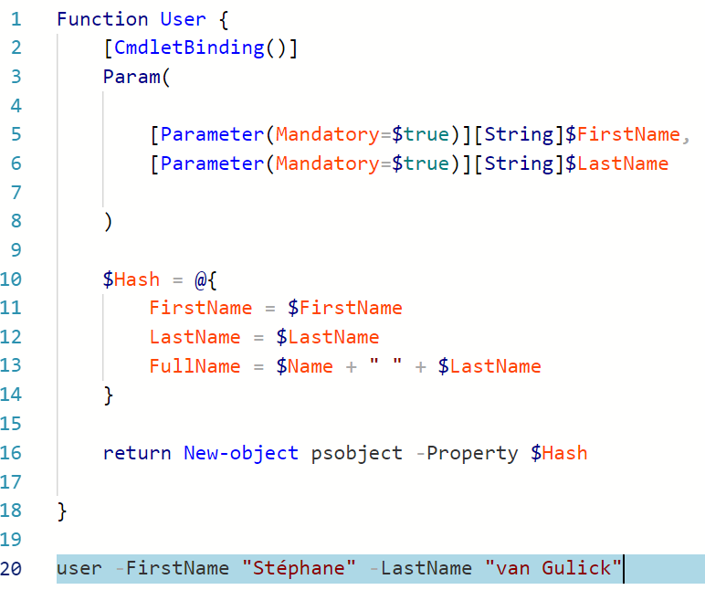
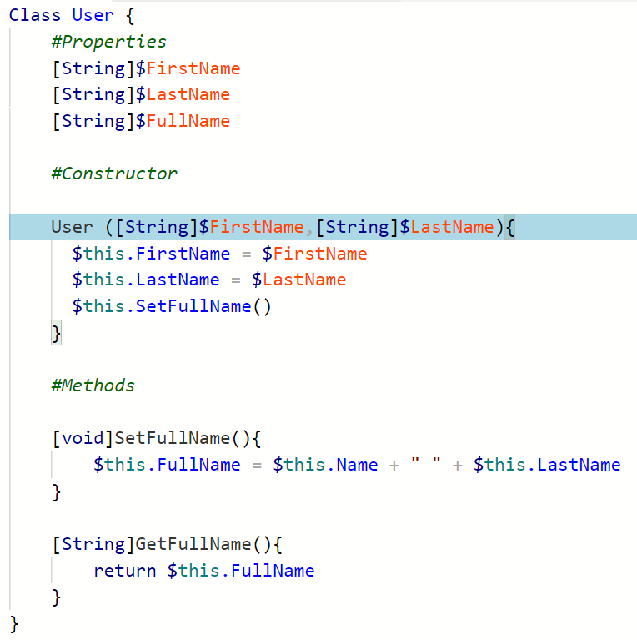
Introduction: assimilating class concepts
Function
Class
15 Septembre 2018 - #FrPwshSat2018

Slide 8
Click!
$Date = Get-Date
$NewTime = $Date.AddDays(5)
$NewTime.Day
15 Septembre 2018 - #FrPwshSat2018

Slide 9
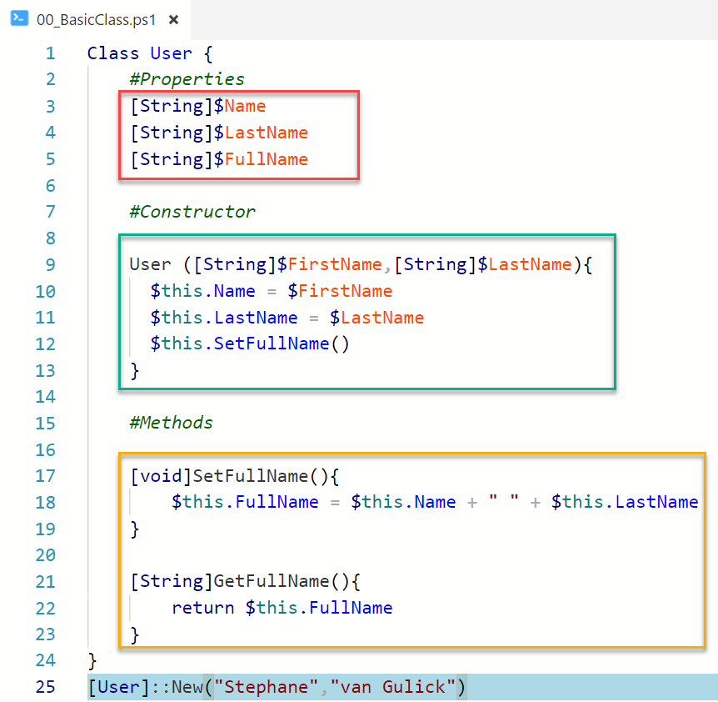
Class Basics
Properties:
Holds information on the object
Constructor:
Creates your object
Methods:
Adds functionality to your object (Like a Function)
Creating an object (Instanciate):
New-Object ClassName
[ClassName]::New()
15 Septembre 2018 - #FrPwshSat2018

Slide 10
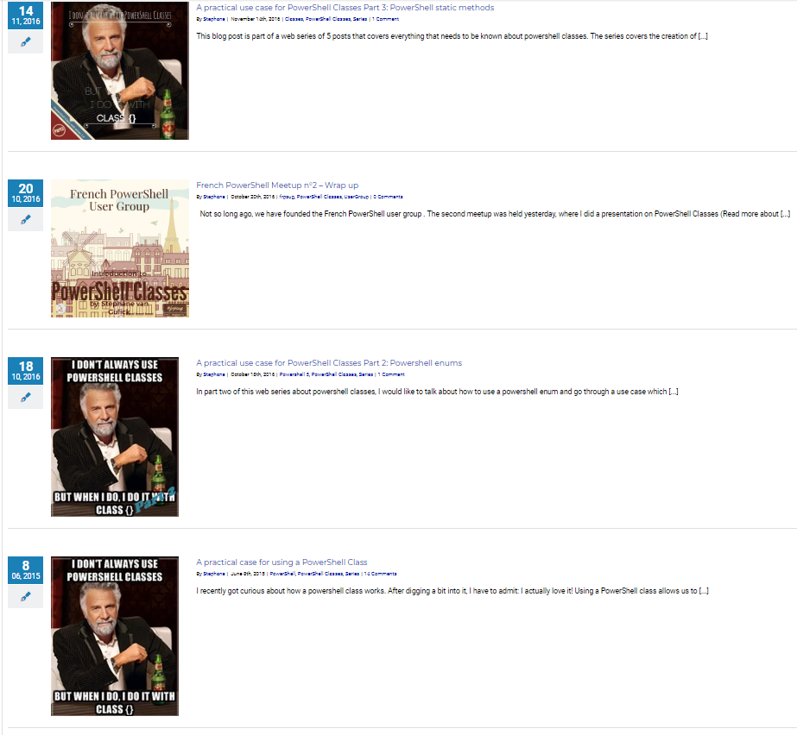
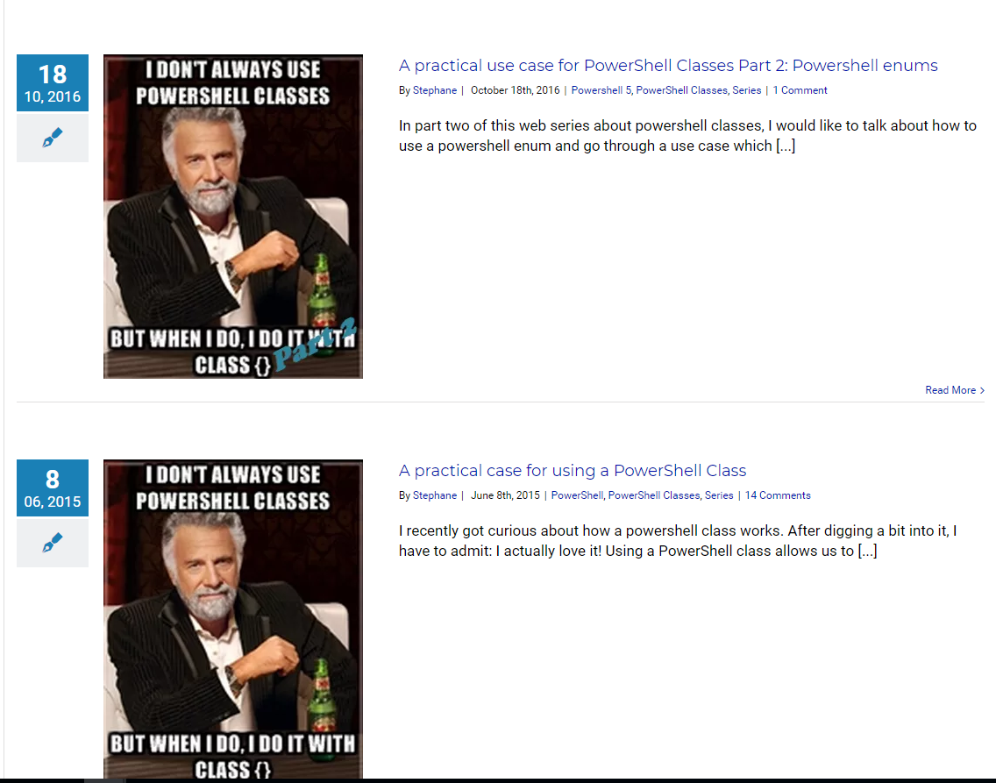
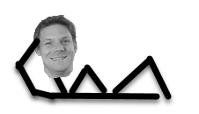
Plan:
15 Septembre 2018 - #FrPwshSat2018

Slide 11
Plan:
$False
15 Septembre 2018 - #FrPwshSat2018

Slide 12
Plan:
Learning what an object was
Learning OOP basics
Reusing knowledge
Looking forward
Making mistakes
15 Septembre 2018 - #FrPwshSat2018

Slide 13

OOP Concepts
Programming guidlines
15 Septembre 2018 - #FrPwshSat2018

Slide 14

OOP: What's that?
Object Oriented Programming
15 Septembre 2018 - #FrPwshSat2018

Slide 15
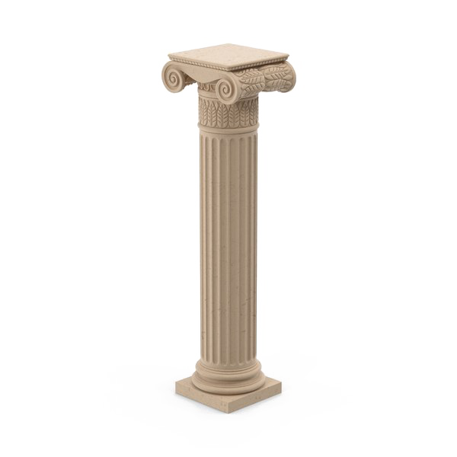
4 pillars of OOP:
Abstraction
Encapsulation
Inheritance
Polymorphism
15 Septembre 2018 - #FrPwshSat2018

Slide 16
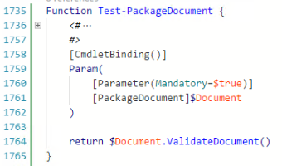

4 Pillars of OOP: Abstraction
Abstraction
15 Septembre 2018 - #FrPwshSat2018

Slide 17
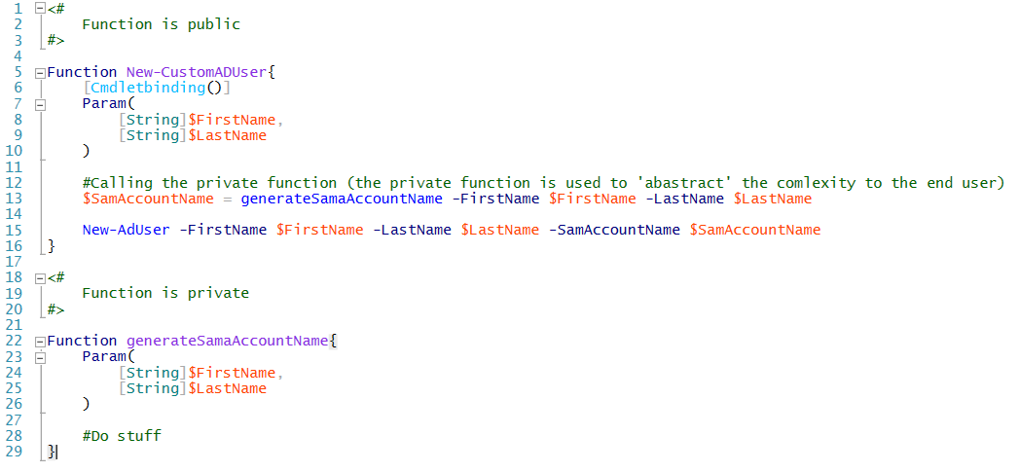
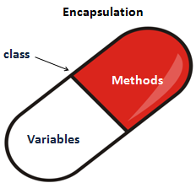
4 Pillars of OOP: encapsulation
encapsulation
15 Septembre 2018 - #FrPwshSat2018

Slide 18
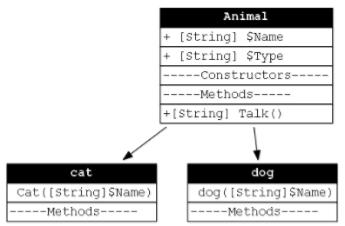
4 Pillars of OOP: inheritance
inheritance
15 Septembre 2018 - #FrPwshSat2018

Slide 19
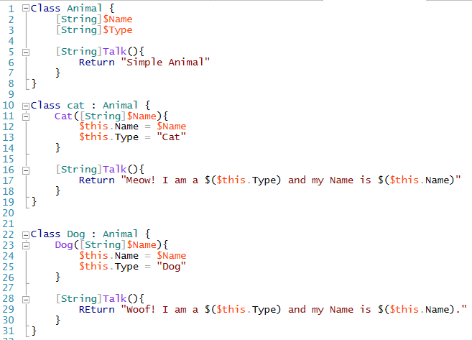
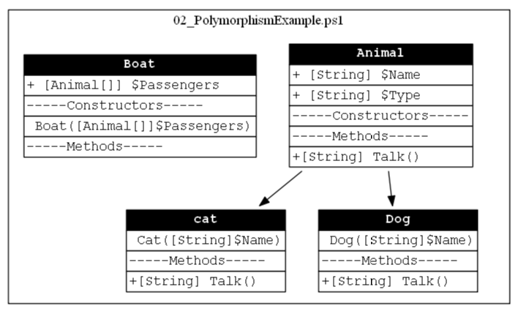

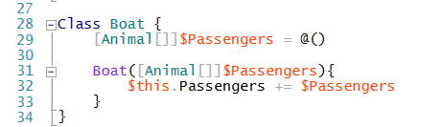
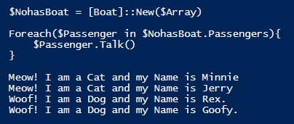
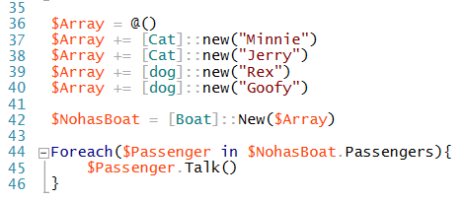
4 Pillars of OOP: polymorphism
???
polymorphism
15 Septembre 2018 - #FrPwshSat2018

Slide 20
Open Source projects using Powershell Classes
My own 'creations' and some really cool ones
15 Septembre 2018 - #FrPwshSat2018

Slide 21
Plan:
Learning what an object was
Learning class basics
Reusing knowledge
Looking forward
Making mistakes
15 Septembre 2018 - #FrPwshSat2018

Slide 22
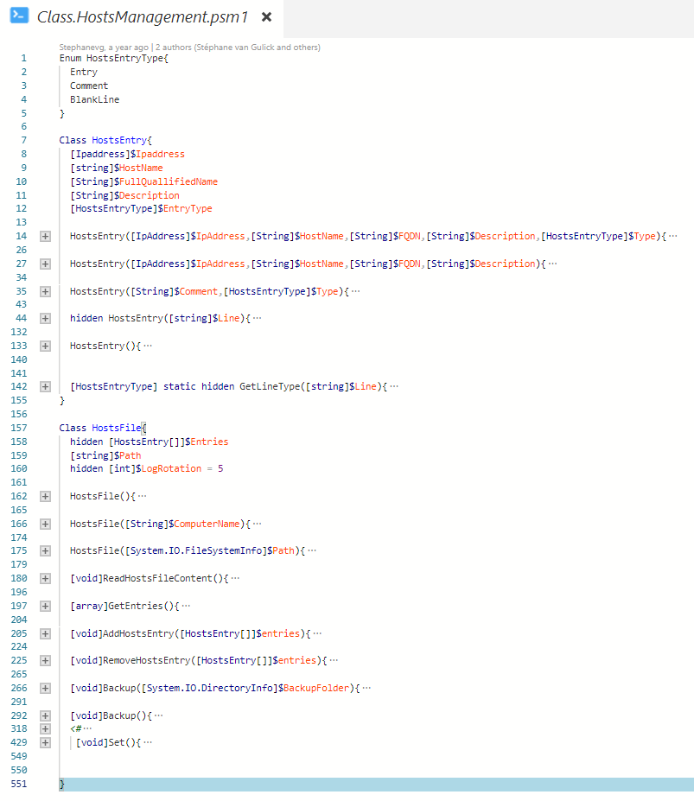

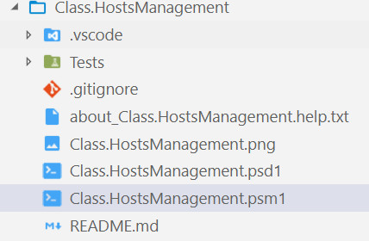
Class.HostsManagement: Me (Stéphane van Gulick)
Simple classes + Enum -> https://github.com/Stephanevg/Class.HostsManagement
15 Septembre 2018 - #FrPwshSat2018
Notes:
2 classes and one enum in one single PSM1 file.
No functions that. Uer needs to create the intances and call the different methods him self.
Draw back → Documentation

Slide 23
Feedback
Feedback Received:
How does it work?
How do I load the module?
How can I do $Something
Where is the help? (get-Help?)
15 Septembre 2018 - #FrPwshSat2018

Slide 24
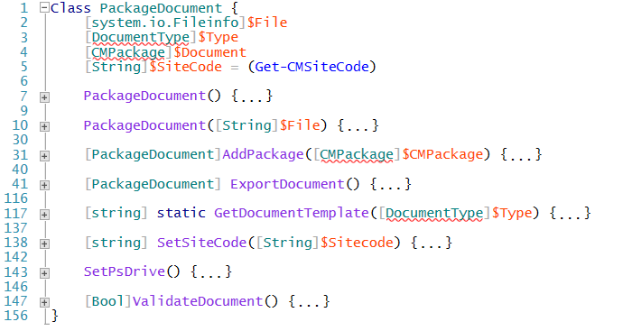
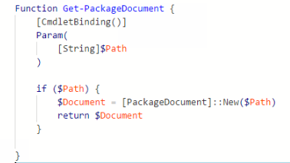
My recommendation: Module Structure using classes
MODULE
Class
Functions
Base functionality
Exposes functionality
15 Septembre 2018 - #FrPwshSat2018

Slide 25
Plan:
Learning what an object was
Learning class basics
Reusing knowledge
Looking forward
Making mistakes
15 Septembre 2018 - #FrPwshSat2018

Slide 26
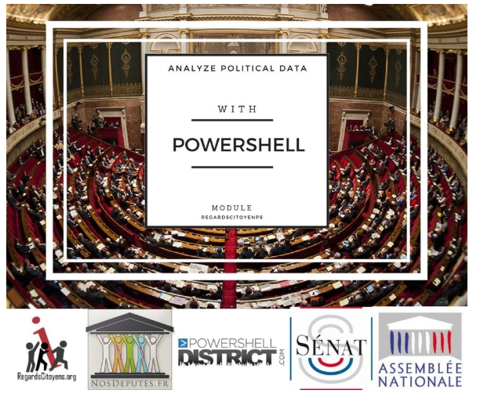
Learning by doing (the right way)
Updated
Encapsulated functionality in class methods. Exposed via classic powershell functions.
Added functions to module (New-blabla, Get-Blabla etc..)
Added comment based help in functions
Added About_help file
Used ScriptsToProcess
15 Septembre 2018 - #FrPwshSat2018

Slide 27
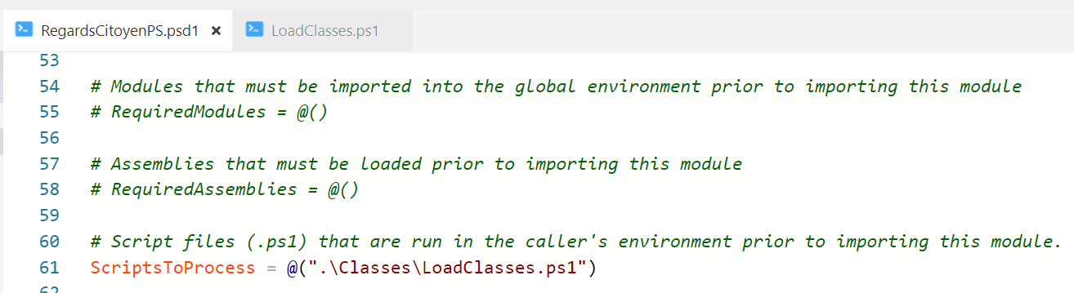
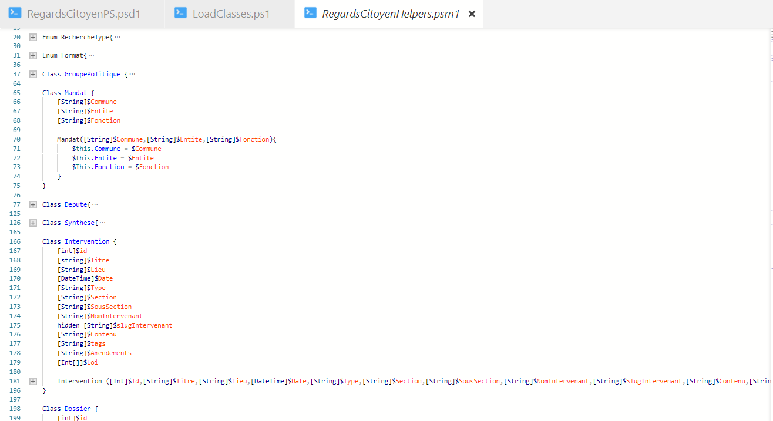
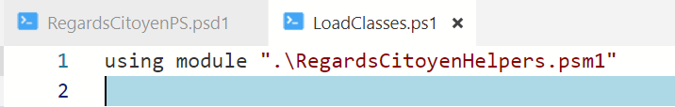
Simplify import of modules using classes
15 Septembre 2018 - #FrPwshSat2018

Slide 28
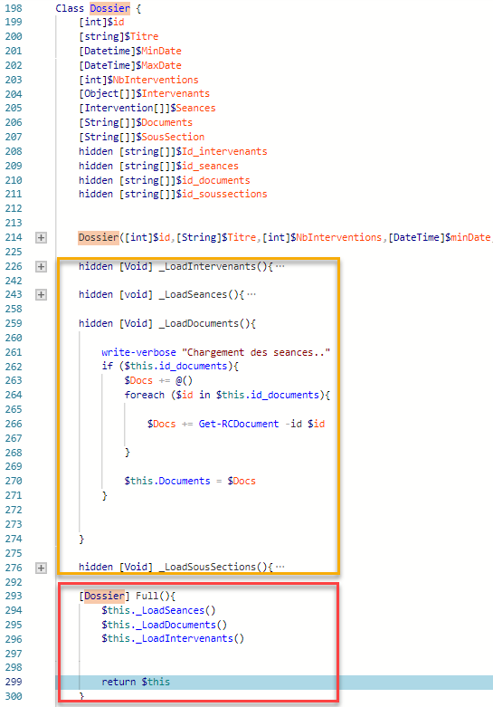
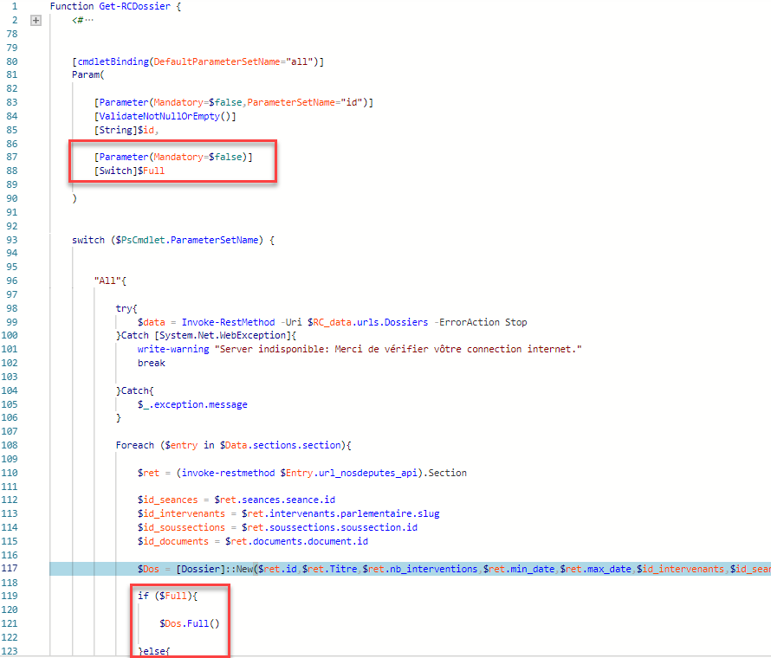
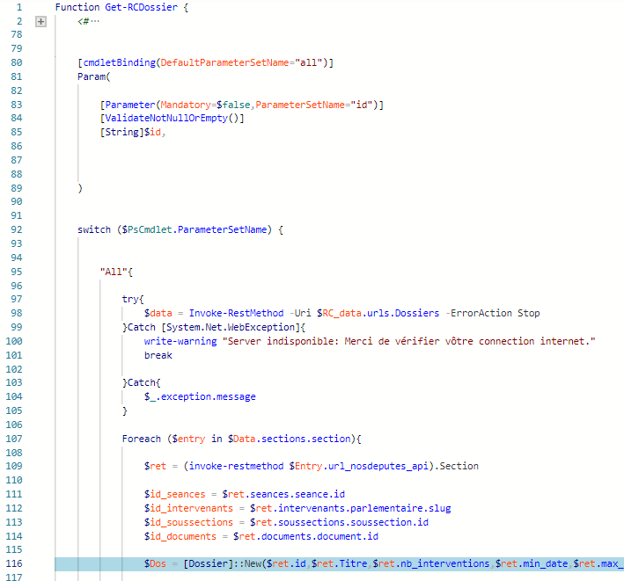
Example from the field
15 Septembre 2018 - #FrPwshSat2018

Slide 29
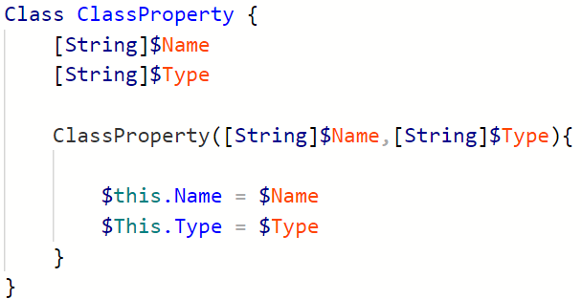
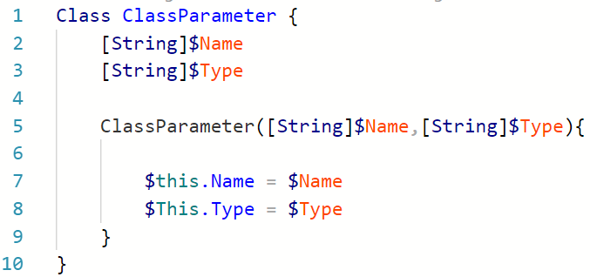
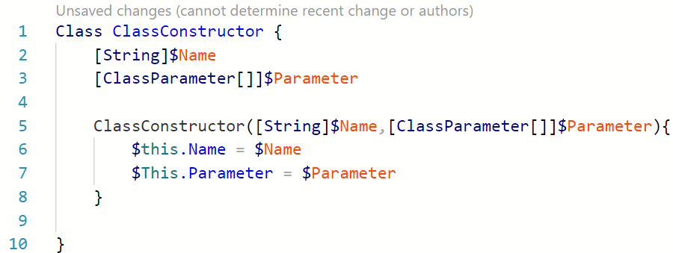
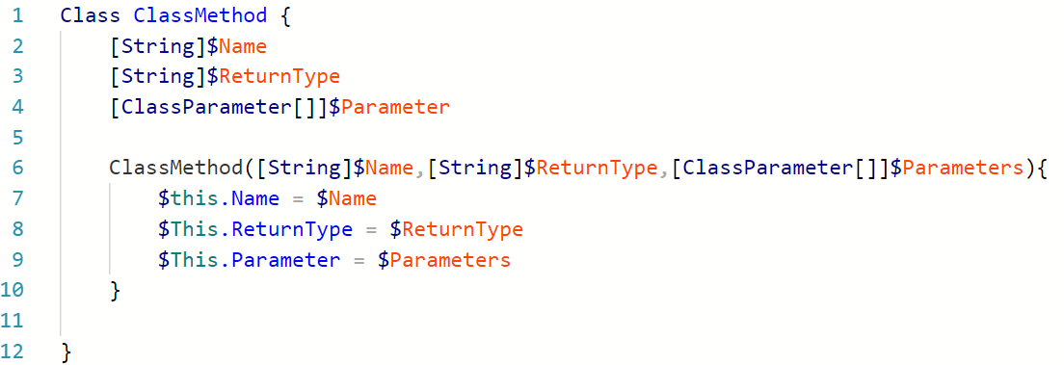
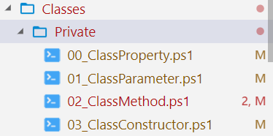
PsClassUtils – Stéphane van Gulick (me)
Simple classes
15 Septembre 2018 - #FrPwshSat2018

Slide 30
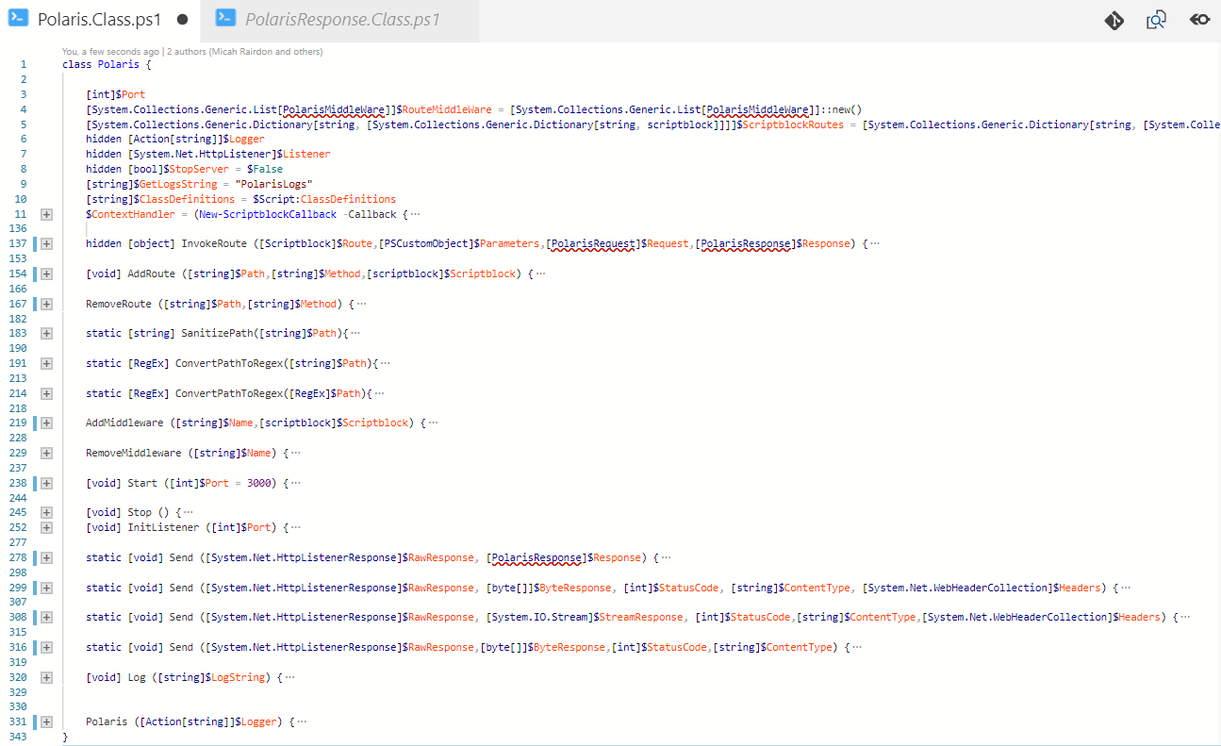
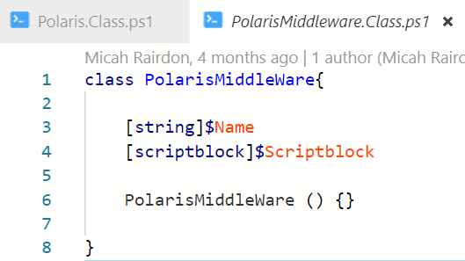
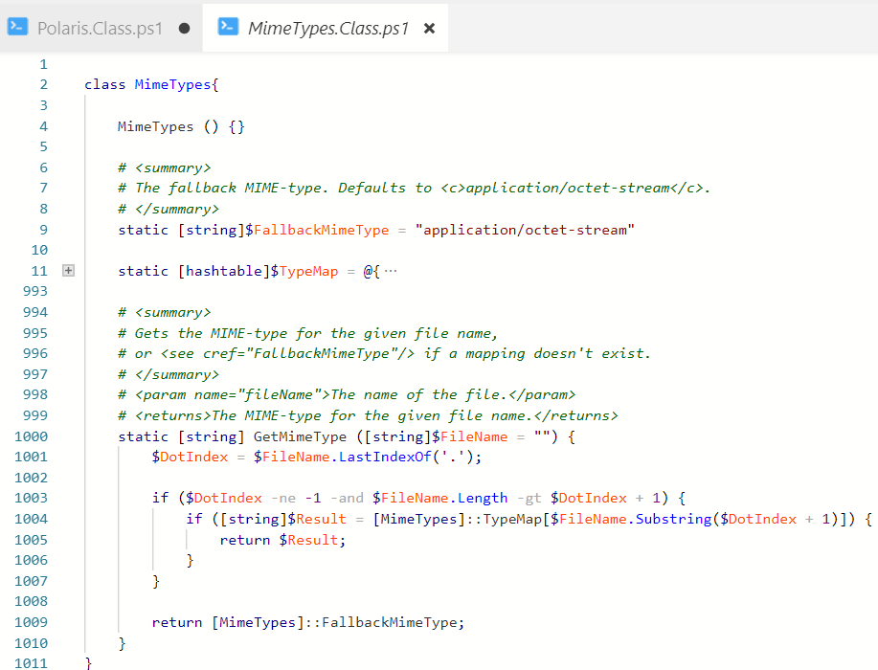
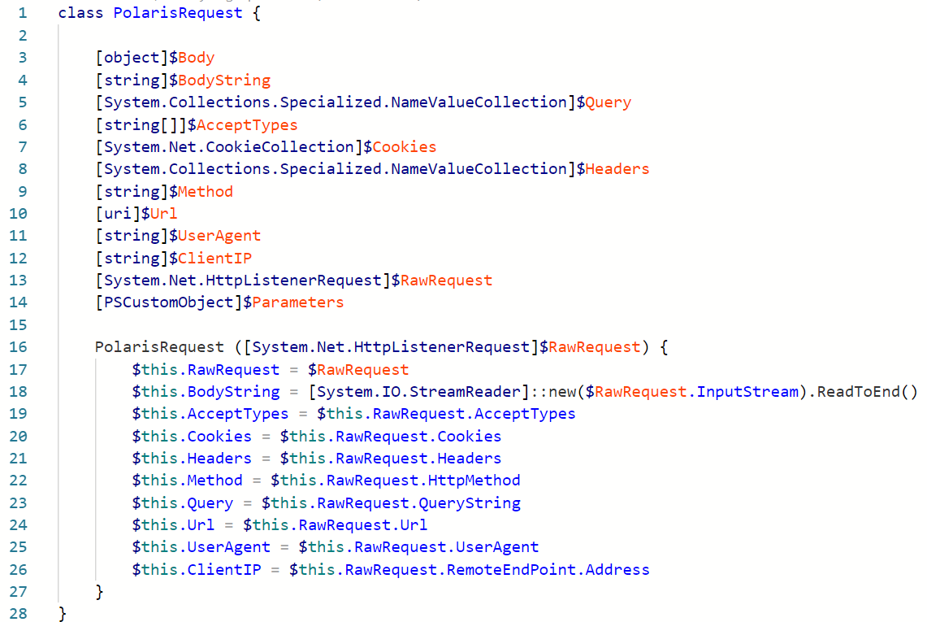
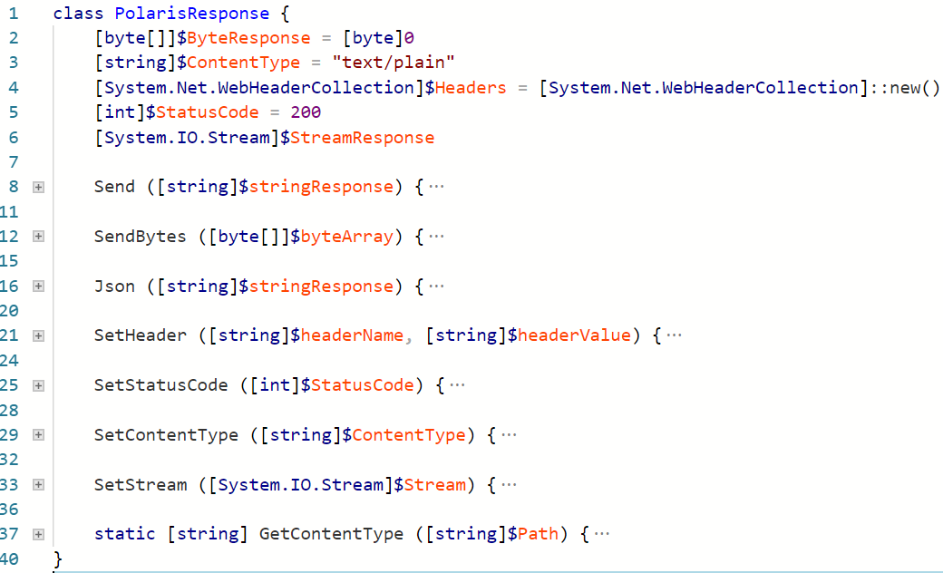
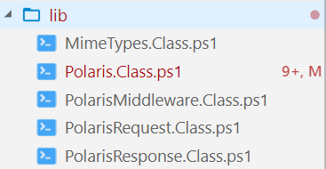
Polaris – Microsoft
https://github.com/PowerShell/Polaris - (5 'big' classes)
15 Septembre 2018 - #FrPwshSat2018

Slide 31
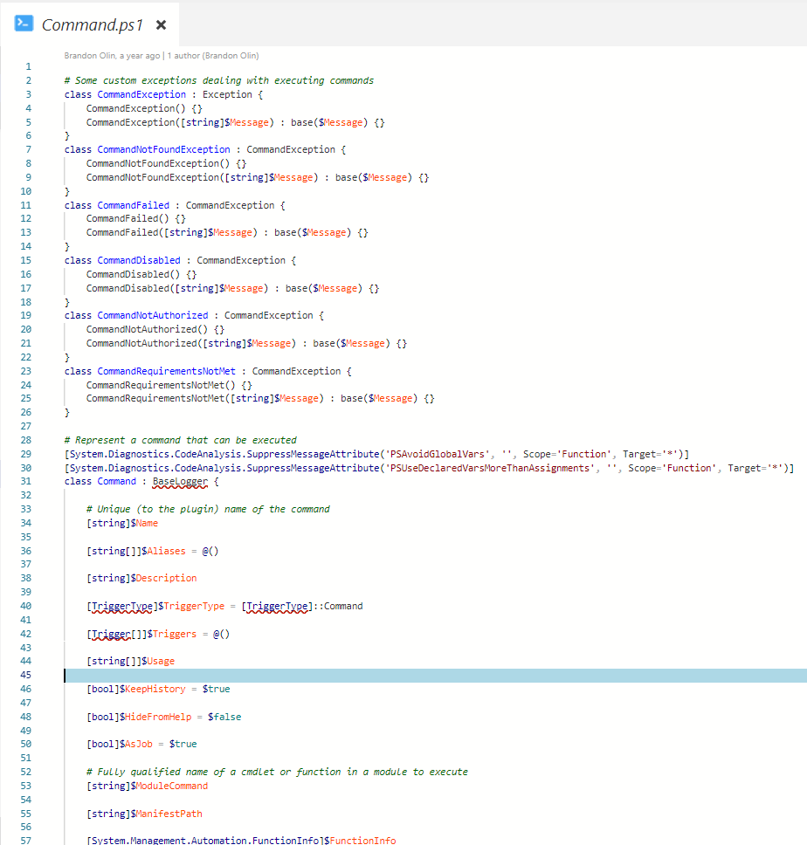
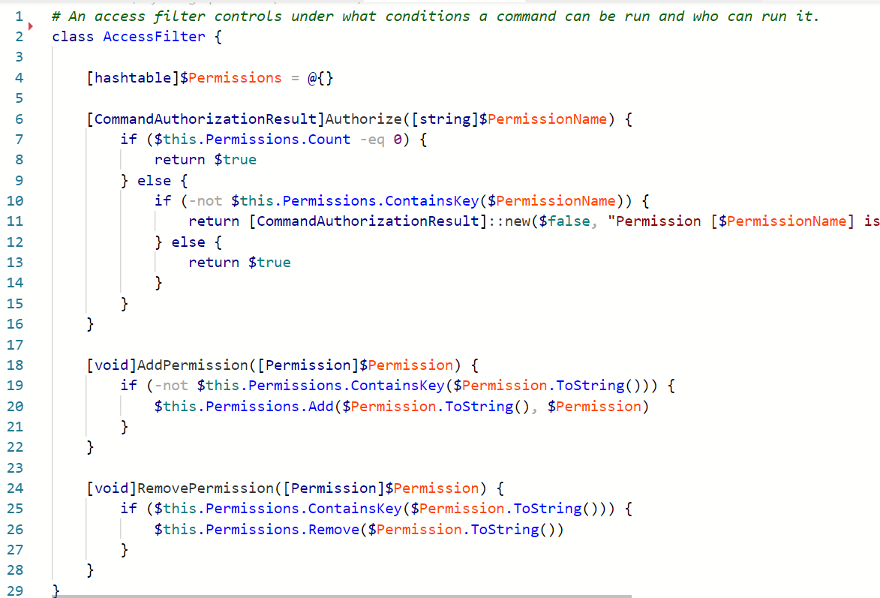
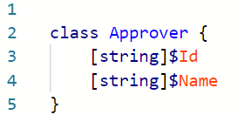
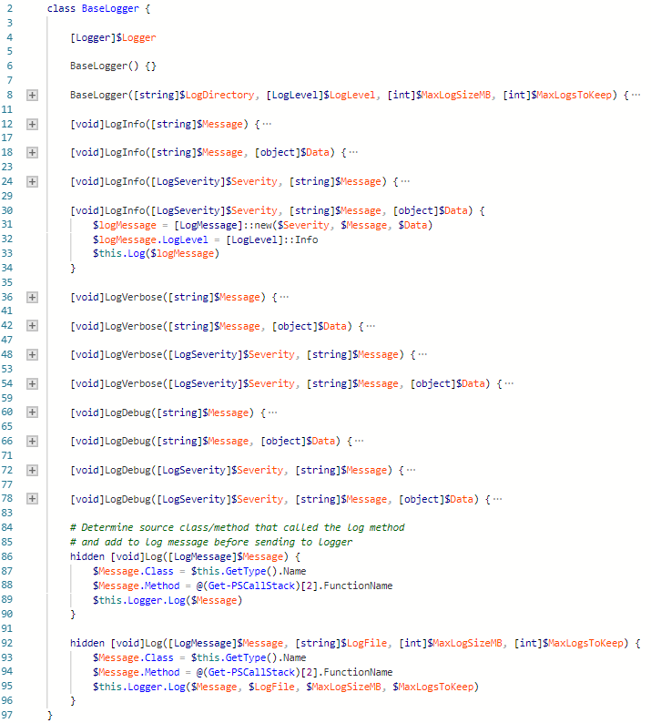
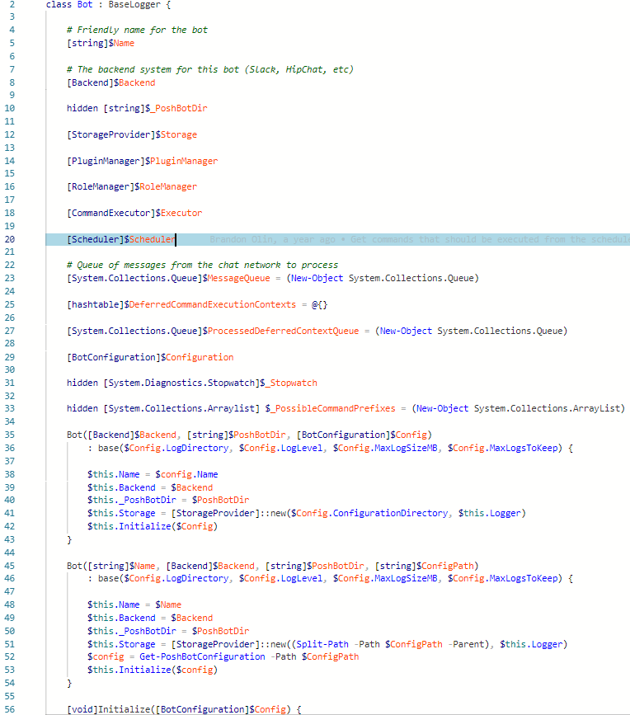
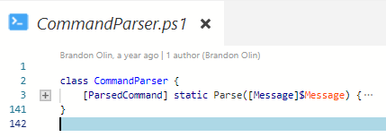
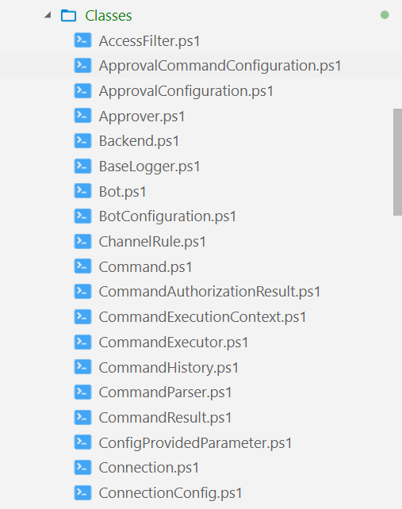
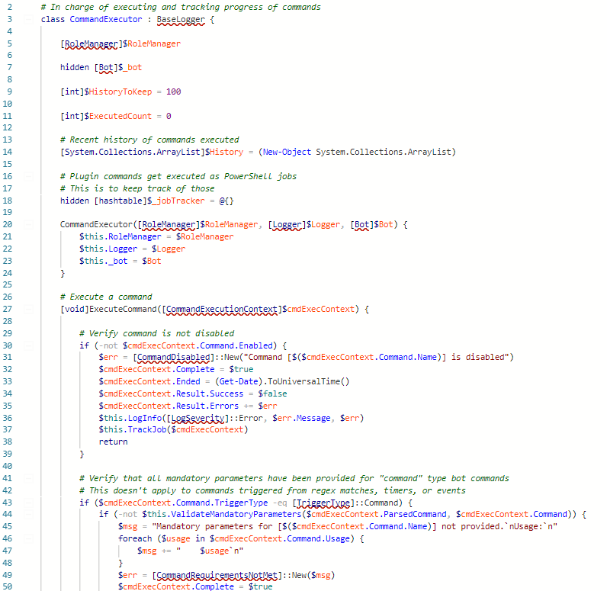
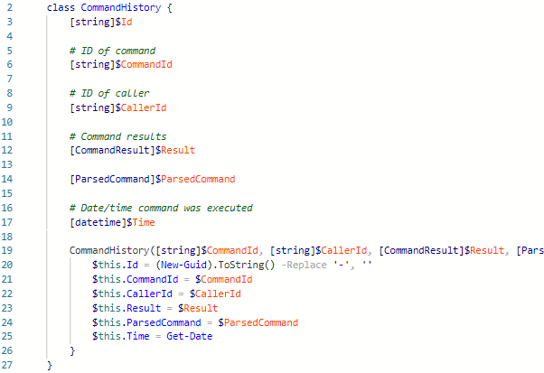

PoshBot – Brandon Olin
https://github.com/poshbotio/PoshBot
43 Classes!
15 Septembre 2018 - #FrPwshSat2018

Slide 32

My key take aways:
1) Write core logic in classes
2) abstract functionality in public methods.
3) Expose functionality to end users through functions (cmdlets)
4) Load functions through ScriptsToProcess
15 Septembre 2018 - #FrPwshSat2018

Slide 33
Taking advantage of existing knowledge
Don't re-invent the wheel
15 Septembre 2018 - #FrPwshSat2018

Slide 34
Plan:
Learning what an object was
Learning class basics
Reusing knowledge
Looking forward
Making mistakes
15 Septembre 2018 - #FrPwshSat2018

Slide 35
Communicate via diagrams: UML
A picture is worth a thousand words
15 Septembre 2018 - #FrPwshSat2018

Slide 36




Communicate via images using UML diagrams
15 Septembre 2018 - #FrPwshSat2018

Slide 37

Communicate via images using UML diagrams
15 Septembre 2018 - #FrPwshSat2018

Slide 38
Generate your own diagrams for your own scripts
PSClassUtils
15 Septembre 2018 - #FrPwshSat2018

Slide 39

Generate your own diagrams for your own scripts
15 Septembre 2018 - #FrPwshSat2018

Slide 40

UML Diagrams
Visual communication
15 Septembre 2018 - #FrPwshSat2018

Slide 41


PsClassUtils – Stéphane van Gulick (me)
Simple class
15 Septembre 2018 - #FrPwshSat2018

Slide 42



Polaris - Microsoft
https://github.com/PowerShell/Polaris
15 Septembre 2018 - #FrPwshSat2018

Slide 43




PoshBot -
Yep…
15 Septembre 2018 - #FrPwshSat2018

Slide 44
Plan:
Learning what an object was
Learning class basics
Reusing knowledge
Looking forward
Making mistakes
15 Septembre 2018 - #FrPwshSat2018

Slide 45
Chill:
15 Septembre 2018 - #FrPwshSat2018

Slide 46
Use well known standards:
SOLID
15 Septembre 2018 - #FrPwshSat2018

Slide 47

Use well known standards:
Robert C. Martin (Aka – Uncle Bob)
S
O
L
I
D
15 Septembre 2018 - #FrPwshSat2018

Slide 48
Use well known standards:
Single responsibility principle
One class / method must have
only one responsibility
S
O
L
I
D
15 Septembre 2018 - #FrPwshSat2018

Slide 49
Use well known standards:
Open Closed Principle
Open for extension
But
Closed for modification
S
O
L
I
D
15 Septembre 2018 - #FrPwshSat2018

Slide 50
Use well known standards:
Ability to replace any instance of a parent class with an instance of one of its child classes without side effects
S
O
L
I
D
Liskov substitution principle
15 Septembre 2018 - #FrPwshSat2018

Slide 51
Use well known standards:
S
O
L
I
D
Write a lot of small interfaces instead of one huge interface
A class should not be forced to depend on methods it doesn't use
Interface segragation principle
15 Septembre 2018 - #FrPwshSat2018

Slide 52
Use well known standards:
High level Modules should not depend on low level implementations
S
O
L
I
D
The ActiveDirectory Module should depend on your script to work.
The ActiveDirectory Module should not depend on your script
Dependency inversion principle
15 Septembre 2018 - #FrPwshSat2018

Slide 53

Use well known standards:
Single responsibility principle
Open Closed principle
S
O
L
I
D
Liskov Substitution principle
Interface segragation principle
Dependency inversion principle
15 Septembre 2018 - #FrPwshSat2018

Slide 54
New Concepts
15 Septembre 2018 - #FrPwshSat2018

Slide 55
Plan:
Learning what an object was
Learning class basics
Reusing knowledge
Looking forward
Making mistakes
15 Septembre 2018 - #FrPwshSat2018

Slide 56
Use well known standards:
TDD
Test Driven Developement
15 Septembre 2018 - #FrPwshSat2018

Slide 57
Test Driven Developement:
Concepts
You are NOT allowed to write production code that DOESN'T has a test.
Write a test, and make it fail
1
2
3
Write ONLY enough production code to make the test pass.
Write a test, and make it fail
15 Septembre 2018 - #FrPwshSat2018

Slide 58


Design patterns
Gang of four
15 Septembre 2018 - #FrPwshSat2018

Slide 59

Design pattern: Example
State Pattern
15 Septembre 2018 - #FrPwshSat2018

Slide 60

Design pattern: Example
State Pattern
15 Septembre 2018 - #FrPwshSat2018

Slide 61





Design pattern: Example
State Pattern
15 Septembre 2018 - #FrPwshSat2018

Slide 62


Design pattern: Example
State Pattern
15 Septembre 2018 - #FrPwshSat2018

Slide 63
Design pattern: Example
State Pattern
15 Septembre 2018 - #FrPwshSat2018

Slide 64
Design pattern: Key take aways
State Pattern
Used different classes to express the notion of 'State'
Each class is (represents) a specific state, with it's own behaviour
Used inheritence
Used Polymorphism
State Pattern
Standard Answer to a common / Well known problem
Reusable design
Reusable Code
15 Septembre 2018 - #FrPwshSat2018

Slide 65


Design pattern: Key take aways
15 Septembre 2018 - #FrPwshSat2018

Slide 66

Design pattern: Key take aways
State Pattern
State Pattern
15 Septembre 2018 - #FrPwshSat2018

Slide 67
(My) Next step(s)
15 Septembre 2018 - #FrPwshSat2018

Slide 68
Plan:
Learning what an object was
Learning class basics
Getting curious
Looking forward
Making mistakes
15 Septembre 2018 - #FrPwshSat2018

Slide 69
Use well known standards:
TDD
Test Driven Developement
15 Septembre 2018 - #FrPwshSat2018

Slide 70


Design patterns:
15 Septembre 2018 - #FrPwshSat2018

Slide 71
Design patterns:
Creation Design Patterns
Singleton Pattern
Factory Pattern
Abstract factory
Builder Pattern
Prototype Pattern
Structural Design Patterns
Adapter Pattern
Composite Pattern
Proxy Pattern
Flyweight Pattern
Facade Pattern
Bridge Pattern
Decorator Pattern
Behavioral Design Patterns
State Pattern
Observer Pattern
Strategy Pattern
Iterator Pattern
Visitor Pattern
Template Method
Mediator Pattern
Command Pattern
Interpreter Pattern
Memento Pattern
Chain of responbility pattern
15 Septembre 2018 - #FrPwshSat2018

Slide 72

Books I (really) recommend
https://www.amazon.fr/First-Design-Patterns-Elisabeth-Freeman/dp/0596007124
https://www.amazon.fr/Design-Patterns-Elements-Reusable-Object-Oriented/dp/0201633612
15 Septembre 2018 - #FrPwshSat2018

Slide 73
What do you see?
A bridge!
15 Septembre 2018 - #FrPwshSat2018

Slide 74
15 Septembre 2018 - #FrPwshSat2018

Slide 75
French PowerShell Saturday
Merci à nos sponsors !!
15 Septembre 2018 - #FrPwshSat2018

